Slide 1


Slide 2
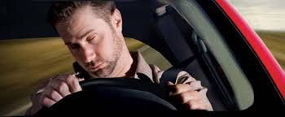
Drowsiness Detection
Drowsiness refers to feeling abnormally sleepy during the day. People who are drowsy may fall asleep in inappropriate situations or at inappropriate times.
Driver drowsiness detection is a car safety technology which helps prevent accidents caused by the driver getting drowsy. Various studies have suggested that around 20% of all road accidents are fatigue-related, up to 50% on certain roads.

Slide 3
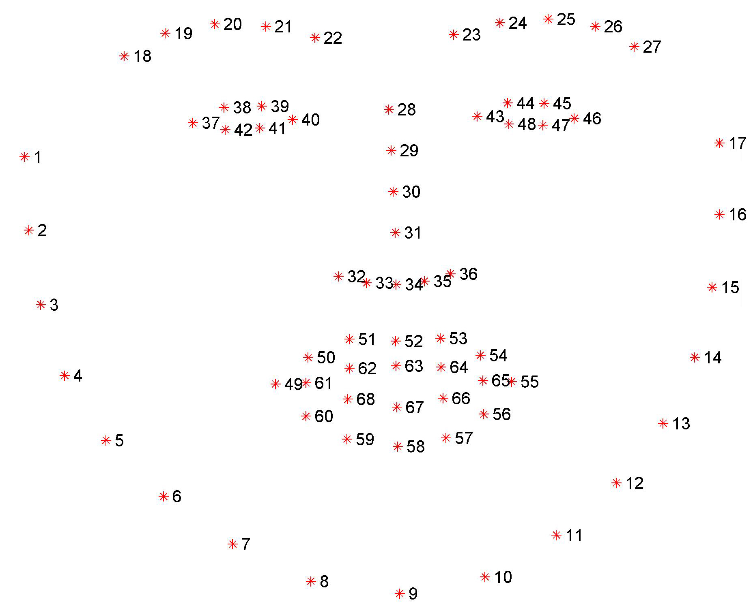
dlib’s facial landmark detector
The pre-trained facial landmark detector inside the dlib library is used to estimate the location of 68 (x, y)-coordinates that map to facial structures on the face.
Facial landmarks are used for localizing and representing salient regions or facial parts of the person’s face, such as:
Nose
Jaws
Left eye
Right eye
Left eyebrow
Mouth
Right eyebrow

Slide 4
dlib’s facial landmark detector.
The Locations of the Facial Parts are as follows:
The left eye is accessed with points [42, 47].
The mouth is accessed through points [48, 67].
The left eyebrow is accessed through points [22, 26].
The nose is accessed using points [27, 34].
The right eyebrow is accessed through points [17, 21].
The right eye is accessed using points [36, 41].
And the jaw is accessed via points [0, 16].

Slide 5
Block Diagram – Workflow
Loading Face Detector & Landmark Predictor
Reading Frame from camera
Converting frame from BGR to Gray
Detecting Face
Identifying Left & Right eye Coordinate
Finding Eye Aspect Ratio
Eye close detection

Slide 6
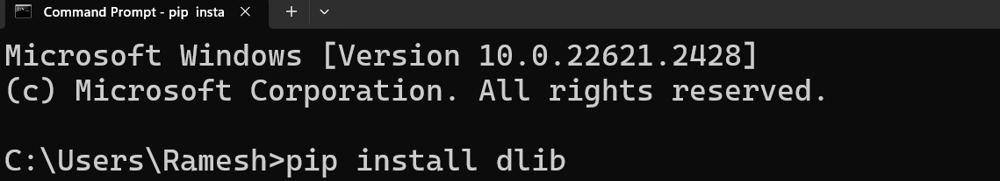
Installing Libraries
PyQt5: pip install sklearn ; pip install dlib

Slide 7
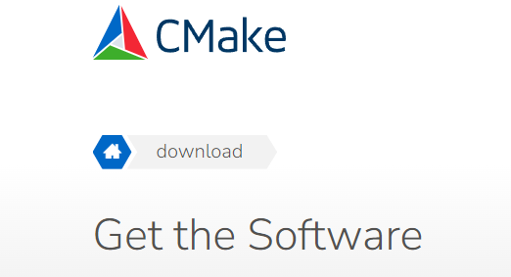
Installing Libraries
Visual C++ Build Tools

Slide 8
Ready For Hands On

Slide 9




THANK YOU☺
NOVITECH COIMBATORE
novitechresearchanddevelopment

